Slide 1
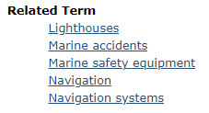
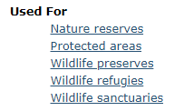
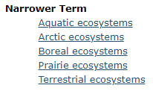
Notes:
This is the alphabetical term display.

Slide 2
Terms not used
Notes:
This is the alphabetical term display.

